Slide 1

Smart Water Quality Monitoring System
ClearWatts

Slide 2

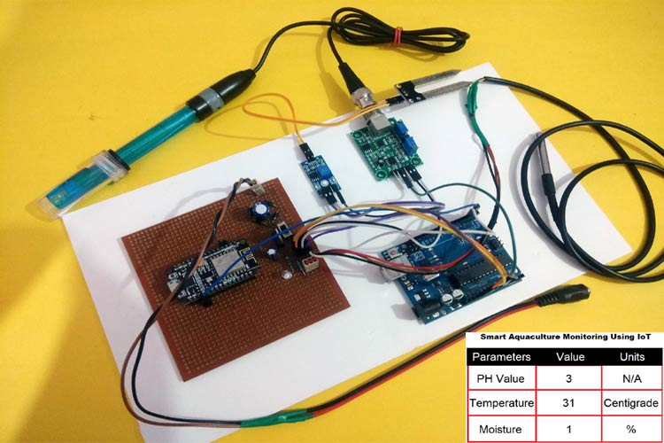
Abstract
This project introduces ClearWatts, an AI-powered Smart Water Quality Monitoring System that integrates advanced IoT hardware such as pH sensors, turbidity sensors, dissolved oxygen sensors, and conductivity meters, along with microcontrollers like Arduino or Raspberry Pi for data acquisition and transmission. These devices collect real-time data on water quality, which is processed through cloud analytics and AI-driven algorithms for predictive insights. The system enables early detection of contamination, allowing for timely interventions. By combining robust hardware with intelligent software, ClearWatts enhances water management practices, promotes environmental sustainability, and safeguards public health.

Slide 3

Introduction
Water Quality Threats: Increasing pollution from industrial waste, agricultural runoff, and other contaminants poses a major risk to water quality and public health.Current water quality monitoring methods are often manual, time-consuming, and lack real-time data, making it difficult to detect and respond to contamination in a timely manner.
Hardware Components: Utilizes sensors and microcontrollers (e.g., Arduino, Raspberry Pi) to collect and transmit data.Then data is processed in the cloud using AI algorithms, offering real-time analysis and predictive capabilities.
Sustainability and Global Impact : Supports sustainable water management practices, aligning with environmental goals like the UN's Sustainable Development Goals (SDGs).
Goal: To provide an efficient, automated, and scalable solution for improving water quality monitoring and ensuring safe, clean water access through timely detection and actionable insights.

Slide 4
Literature Survey in Table Format
S.No. | Title | Journal Name | Year | Review
1 | IEEE Internet of Things Journal | Quality Assessment and Monitoring of River Water Using IoT Infrastructure | 2023 | IoT technology automates water quality monitoring, providing valuable insights into river health and pollution.
2 | IEEE Sensors Journal | Design and Implementation of a Full-Time Artificial Intelligence of Things-Based Water Quality Inspection and Prediction System for Intelligent Aquaculture | 2024 | Enables accurate, continuous water quality prediction for aquaculture management..
3 | IEEE Transactions on Sustainable Computing | Quality Risk Analysis for Sustainable Smart Water Supply Using Data Perception | 2019 | Proposed risk analysis framework improves urban water quality monitoring, enhancing prediction accuracy and decision support.

Slide 5
Limitations Identified from Literature Survey
Title | Journal Name | Limitations
IEEE Internet of Things Journal | Quality Assessment and Monitoring of River Water Using IoT Infrastructure | Lack of detailed calibration protocols for sensors may compromise accuracy in water quality measurements.
IEEE Sensors Journal | Design and Implementation of a Full-Time Artificial Intelligence of Things-Based Water Quality Inspection and Prediction System for Intelligent Aquaculture | Algae growth on sensors can still affect measurement accuracy despite improved monitoring techniques.
IEEE Transactions on Sustainable Computing | Quality Risk Analysis for Sustainable Smart Water Supply Using Data Perception | Insufficient exploration of long-term ecological effects limits understanding of pollution consequences on aquatic ecosystems.

Slide 6
Research Objectives
Real-Time Monitoring: Develop a system to continuously monitor key water quality parameters such as pH, turbidity, dissolved oxygen, and conductivity using IoT sensors.
Predictive Analytics: Integrate AI algorithms to analyze collected data and predict potential contamination events, enabling proactive interventions.
Energy Efficiency: Design the hardware and software components to minimize energy consumption, facilitating operation in remote or off-grid locations.
User-Friendly Interface: Create an intuitive dashboard for stakeholders to visualize data trends, receive alerts, and access real-time insights on water quality.
Scalability: Ensure the system architecture supports easy integration of additional sensors and functionalities for future expansion.
Sustainability Support: Contribute to sustainable water management practices by providing ationable insights and recommendations based on real-time data analysis.

Slide 7
Justification to SDG 6 : Clean Water and Sanitation
Continuous Water Quality Monitoring: The system ensures 24/7 real-time assessment of critical water quality parameters, helping maintain safe water access.
Early Contamination Detection: By detecting pollutants early, the system enables timely interventions, reducing health risks related to water contamination.
Data-Driven Water Management: Provides actionable insights to authorities and stakeholders for informed decisions on water treatment and resource allocation.
Promoting Safe Water Access: Enhances the ability to track water quality in both urban and rural areas, contributing to the broader goal of universal access to clean water.
Reducing Pollution: Helps identify sources of water pollution and mitigates its impact by enabling proactive corrective measures, supporting environmental conservation.
Supporting Sustainable Practices: Encourages responsible water consumption and conservation through accurate, real-time monitoring, aligning with long-term sustainability goals.

Slide 8

Timeline
Project Review 1:
Project Kick-off & Initial Development
Project Review 2:
System Implementation & Coding Including Testing
Project review 3:
11th November
2024
Present the final project

